Slide 1


AIRBNB PROPERTY PRICING FORECASTING
Shravan Rao – srao53@uic.edu

Slide 2


Problem Statement
1
6
It will also helps the user to better evaluate their choices for the price.
Airbnb is an online marketplace that connects people looking for a place to stay with those willing to rent out their apartments.
2
5
When a new listing is added it will help the host to predict the price at which they can publish/advertise the property
The listings provide a wide variety of choices, from shared beds to luxurious residences, all on one platform for different cities
3
4
The objective of this project is to perform EDA using big data technologies and build models to predict the price for an Airbnb listing
Customers may provide suggestions following a reservation. As a result, the organization's massive collection of data gains additional value.

Slide 3

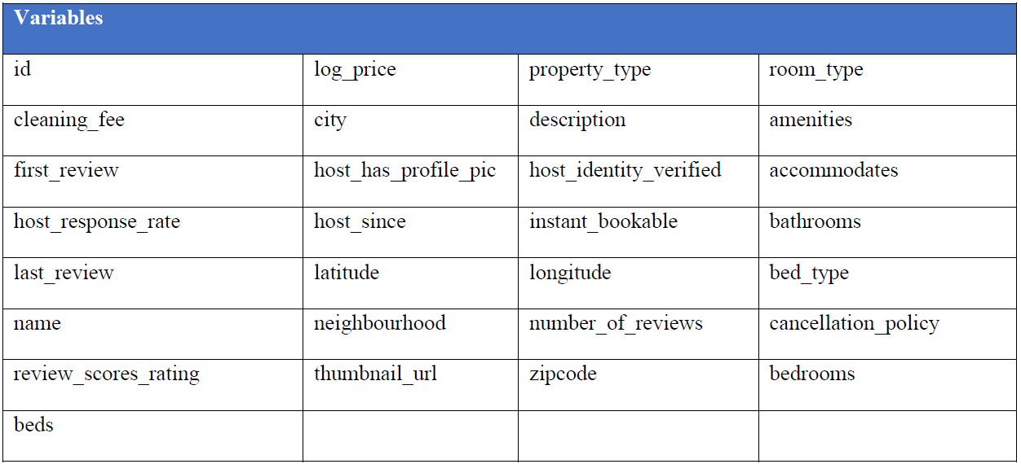
Data Description
The data for Airbnb listings spans from 2015 to 2017 with cities namely NYC, SF, Washington DC, LA, Chicago, Boston
Following are the variables used -
The data can be accessed online via the website (http://insideairbnb.com/get-the-data/).
To make our project cost efficient, we’ve included only the most recent data of size ~100MB with 100,000+ listings having 29 columns.

Slide 4

Methodology
Exploratory Data Analysis
Using Pandas, NumPy, Matplotlib
Modelling & Prediction
Using Pyspark.ml
Data Loading
Data Cleaning & Feature Engineering
Using Pyspark
Using Pyspark

Slide 5






Data Cleaning and Transformation
Step 01
Null value handling using imputation and default value settings
Step 02
Dropping values with no host
Step 03
Transforming date fields into numerical values.
Step 04
Confining data to a defined schema
Exploding amenities to Boolean columns and removing the ones having correlation with log price <0.1
Step 05

Slide 6

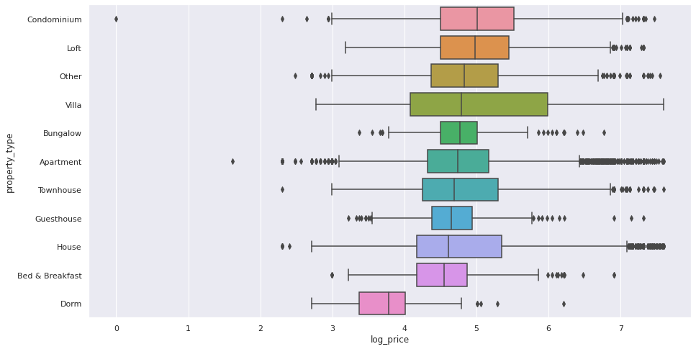
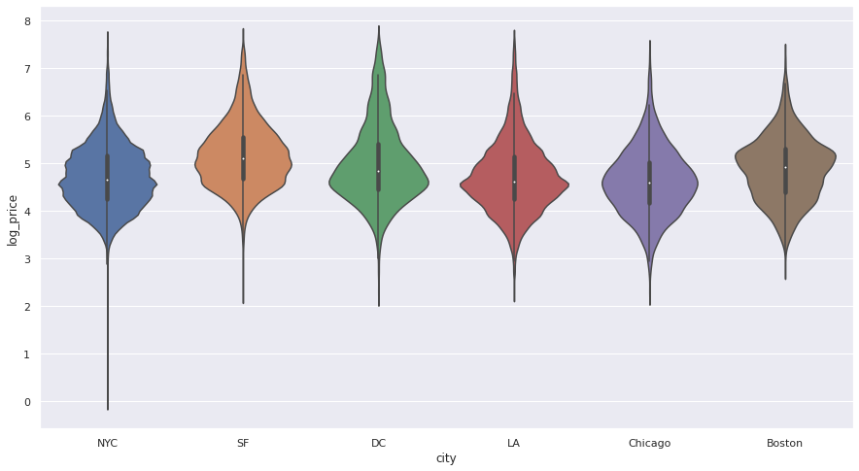
Exploratory Data Analysis

Slide 7
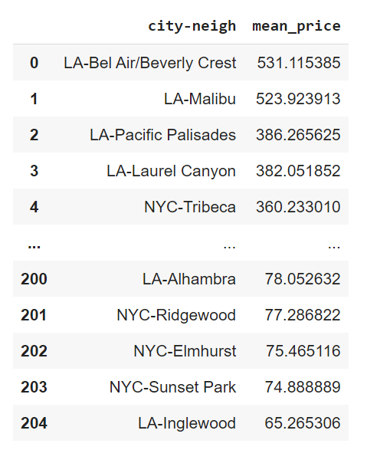
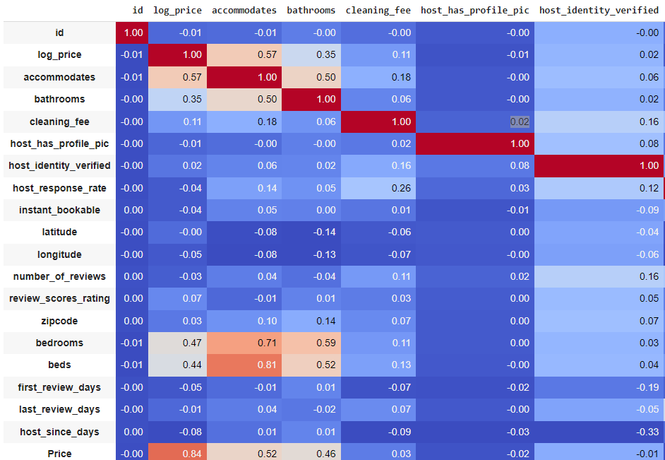
Exploratory Data Analysis

Slide 8
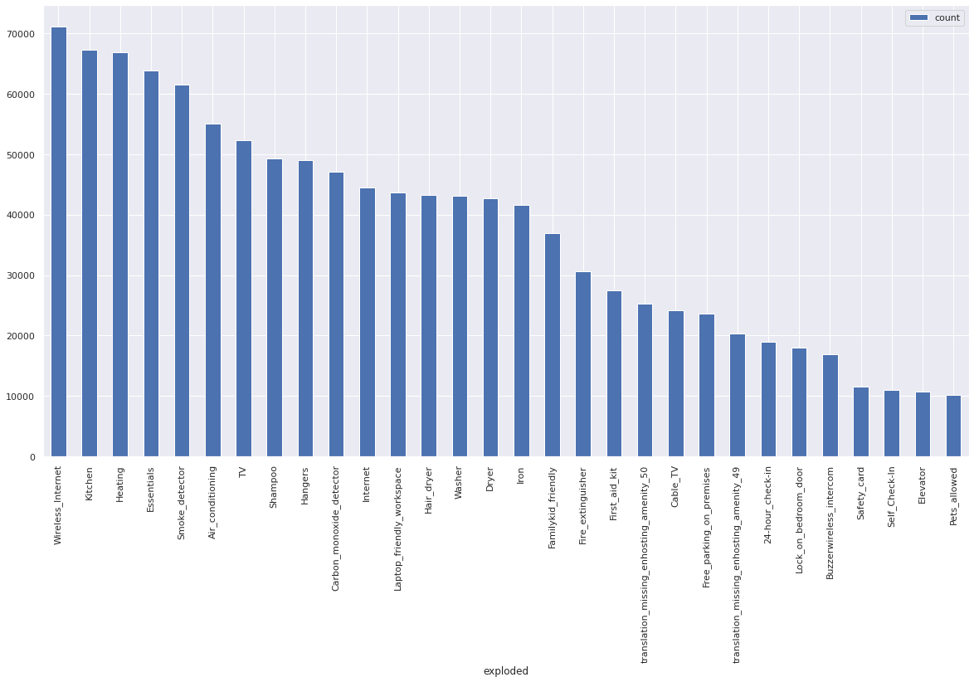
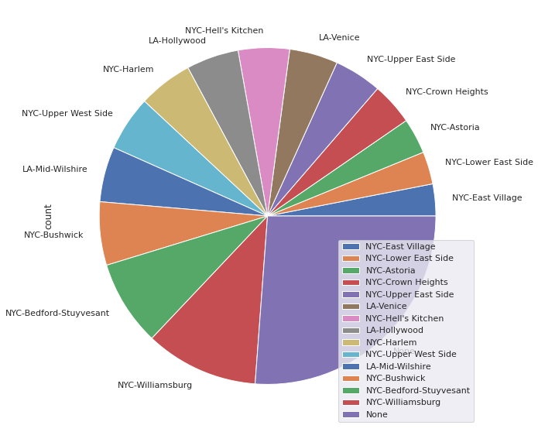
Exploratory Data Analysis

Slide 9

Modeling and Prediction
Polynomial Regression
CV Random Forest (scaled features)
R2: 67.05 %
RMSE: 40.79 %
MAE: 30.23 %
R2: 53.84 %
RMSE: 48.29 %
MAE: 37.04 %
Linear Regression (scaled features)
Random Forest (scaled features)
Decision Tree
(scaled features)
R2: 64.92 %
RMSE: 42.10 %
MAE: 31.30 %
R2: 52.26 %
RMSE: 49.11 %
MAE: 37.55 %
R2: 53.34 %
RMSE: 48.55 %
MAE: 37.46 %

Slide 10
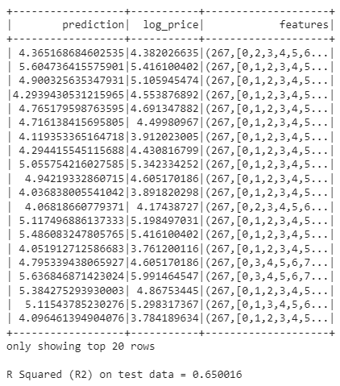

Conclusion
We have successfully used Pyspark on big data for predicting the prices of Airbnb listings.
Through our analysis we can conclude that polynomial regression had the best results.

